Slide 1
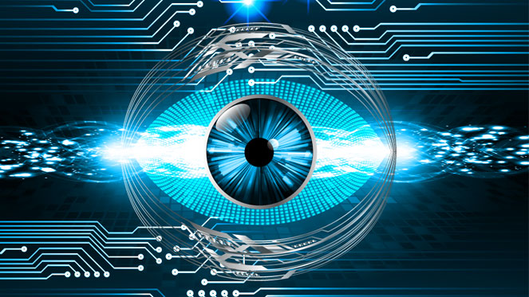
COMPUTER VISION
BY
CH POOJA

Slide 2
WHAT IS COMPUTER VISION?
Enables computers
- to see, identify ,process ,analyze and understand images and videos
-Perform the same kind of tasks as humans.
-Gives appropriate output

Slide 3
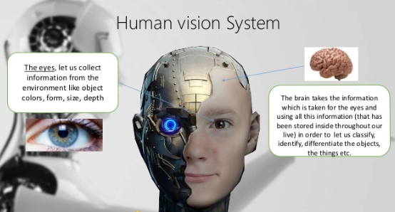

Slide 4
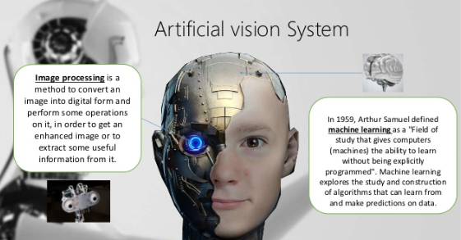

Slide 5
Digital representation of images
2-D array of numbers (intensity values, gray levels)
Gray levels 0 (black) to 255 (white)
Color image is 3 2-D arrays of numbers
Red
Green
Blue
Resolution (number of rows and columns)
128X128
256X256
512X512
640X480

Slide 6
Image Enhancement
Noise reduction ,local contrast enhancement
Algorithms:
-Deconvolution
-Unsharp masking
-Histogram equalization

Slide 7
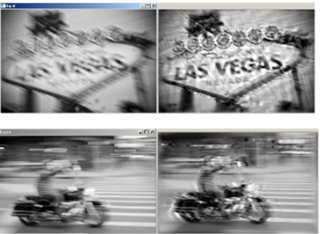
Image Enhancement
Deconvolution-Reducing motion blur below where the motion is known.

Slide 8
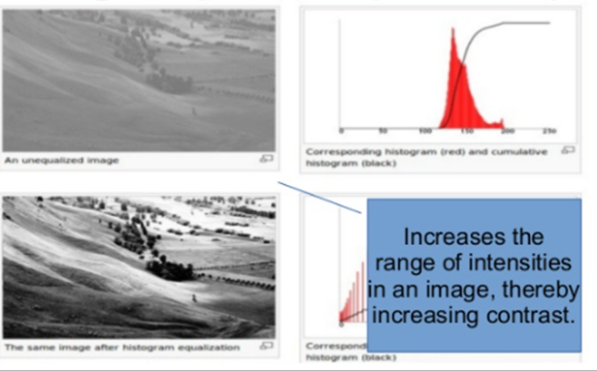
Image Enhancement
Histogram Equalization-Stretches contrast and somewhat corrects for over-or under- exposure

Slide 9
Applications of Computer Vision
Object Recognition
Face Recognition
Video Surveillance and Monitoring
Object detection, tracking and behavior analysis
Remote Sensing: UAVs
Robotics
Computer Graphics

Slide 10
Object Recognition
Finding People in images
Problem 1:Given an image I
Question :Does I contain an image of a person

Slide 11
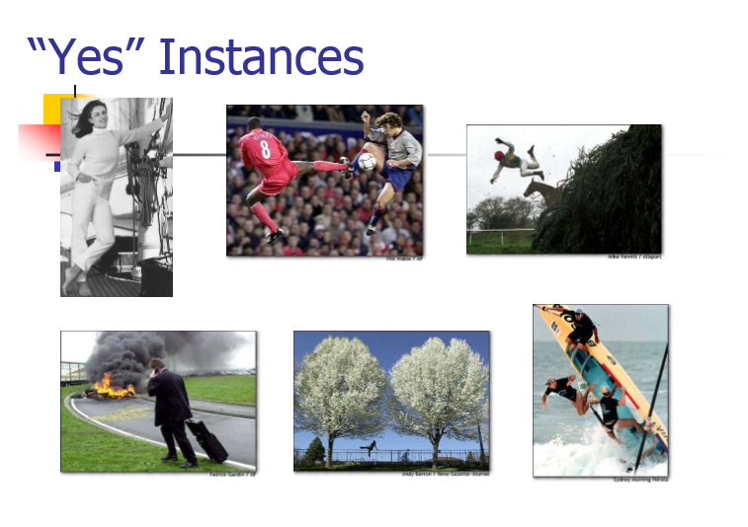

Slide 12
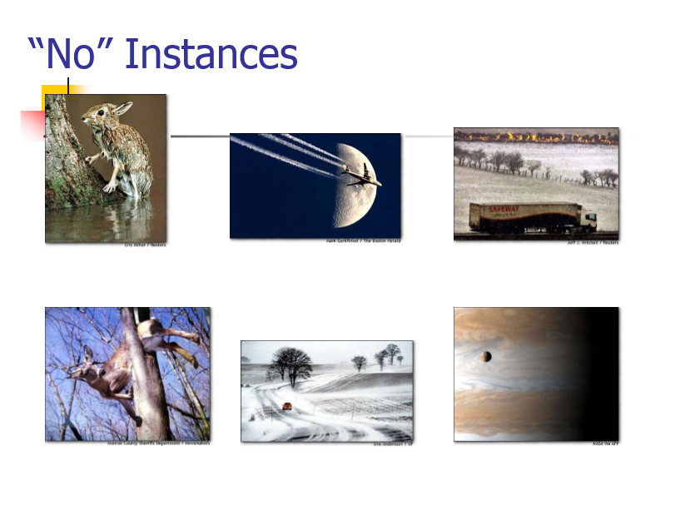

Slide 13
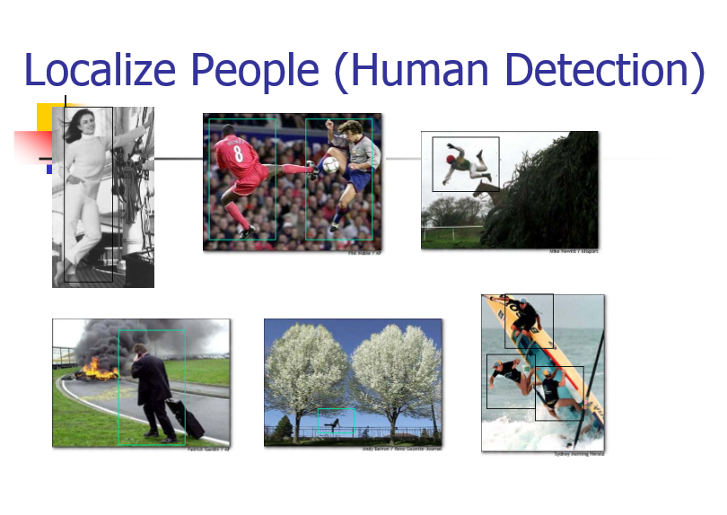

Slide 14
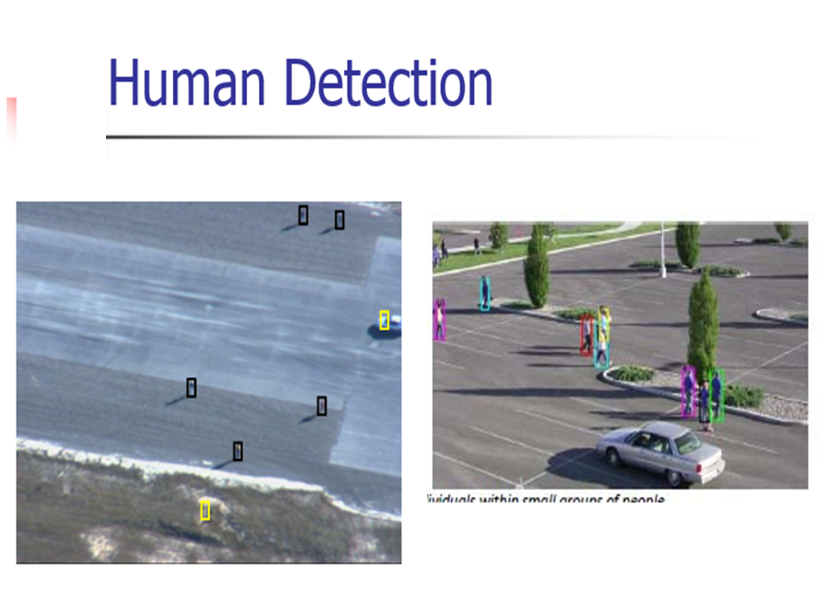

Slide 15
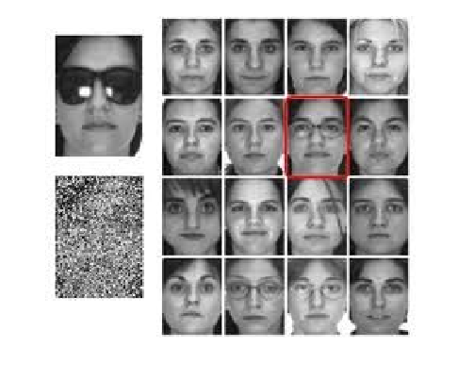
FACE DETECTION AND RECOGNITION

Slide 16
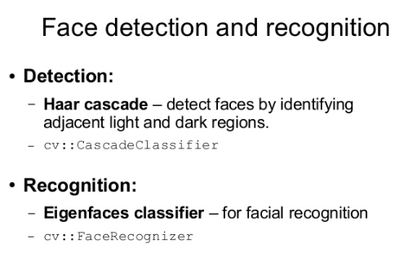

Slide 17
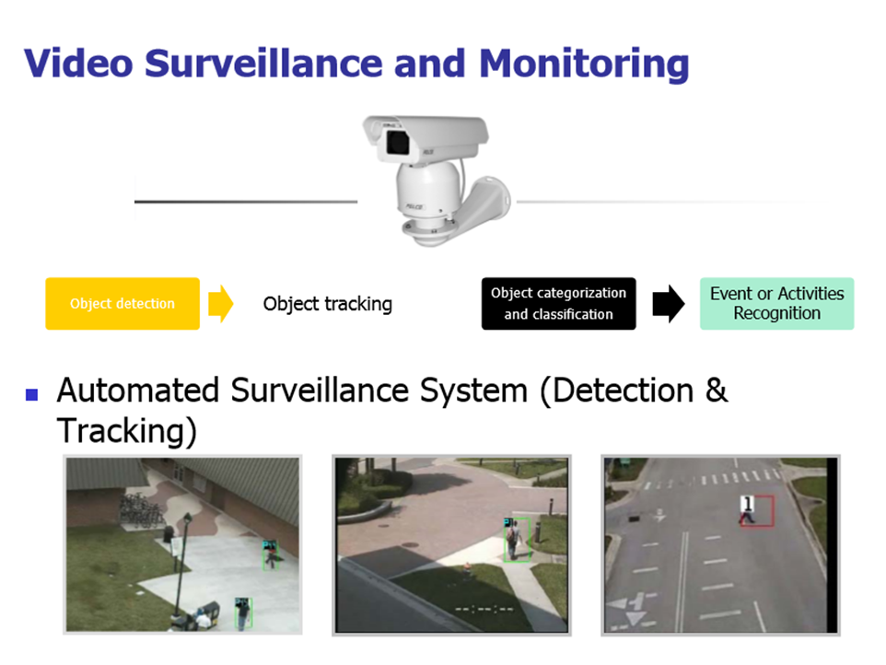

Slide 18
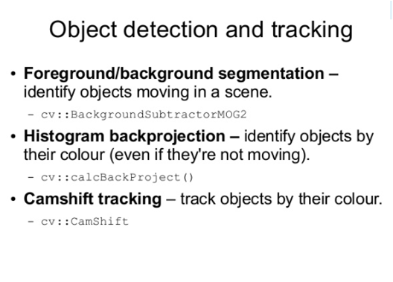

Slide 19
CONCLUSION
Computers can now quickly and accurately recognize
thousands of faces as well as a growing number of other
objects.

Slide 20
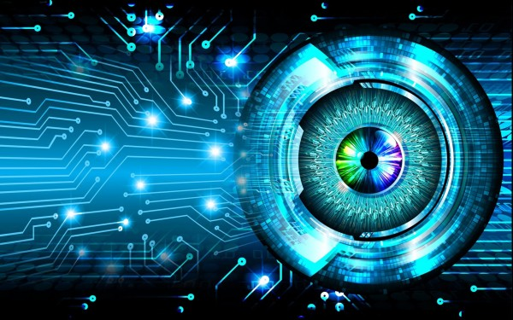
THANK YOU

